Slide 1
Chapter 14 - Advanced C Topics
Outline
14.1 Introduction
14.2 Redirecting Input/Output on UNIX and DOS Systems
14.3 Variable-Length Argument Lists
14.4 Using Command-Line Arguments
14.5 Notes on Compiling Multiple-Source-File Programs
14.6 Program Termination with exit and atexit
14.7 The volatile Type Qualifier
14.8 Suffixes for Integer and Floating-Point Constants
14.9 More on Files
14.10 Signal Handling
14.11 Dynamic Memory Allocation with calloc and realloc
14.12 The Unconditional Branch: goto

Slide 2
Objectives
In this chapter, you will learn:
  To be able to redirect keyboard input to come from a file.
  To be able to redirect screen output to be placed in a file.
  To be able to write functions that use variable-length argument lists.
  To be able to process command-line arguments.
  To be able to assign specific types to numeric constants
  To be able to use temporary files.
  To be able to process unexpected events within a program.
  To be able to allocate memory dynamically for arrays.
  To be able to change the size of memory that was dynamically allocated previously.

Slide 3
14.1 Introduction
Several advanced topics in this chapter
Operating system specific
  Usually UNIX or DOS

Slide 4
14.2 Redirecting Input/Output on UNIX and DOS Systems
Standard I/O - keyboard and screen
  Redirect input and output
Redirect symbol(<)
  Operating system feature, not a C feature
  UNIX and DOS
  $ or % represents command line
  Example:
      $ sum < input
  Rather than inputting values by hand, read them from a file
Pipe command(|)
  Output of one program becomes input of another
      $ random | sum
  Output of random goes to sum

Slide 5
14.2 Redirecting Input/Output on UNIX and DOS Systems
Redirect output (>)
  Determines where output of a program goes
  Example:
      $ random > out
    Output goes into out (erases previous contents)
Append output (>>)
  Add output to end of file (preserve previous contents)
  Example:
      $ random >> out
    Output is added onto the end of out

Slide 6
14.3 Variable-Length Argument Lists
Functions with unspecified number of arguments
  Load <stdarg.h>
  Use ellipsis(...) at end of parameter list
  Need at least one defined parameter
  Example:
      double myfunction ( int i, ... );
  The ellipsis is only used in the prototype of a function with a variable length argument list
  printf is an example of a function that can take multiple arguments
  The prototype of printf is defined as
      int printf( const char* format, ... );

Slide 7
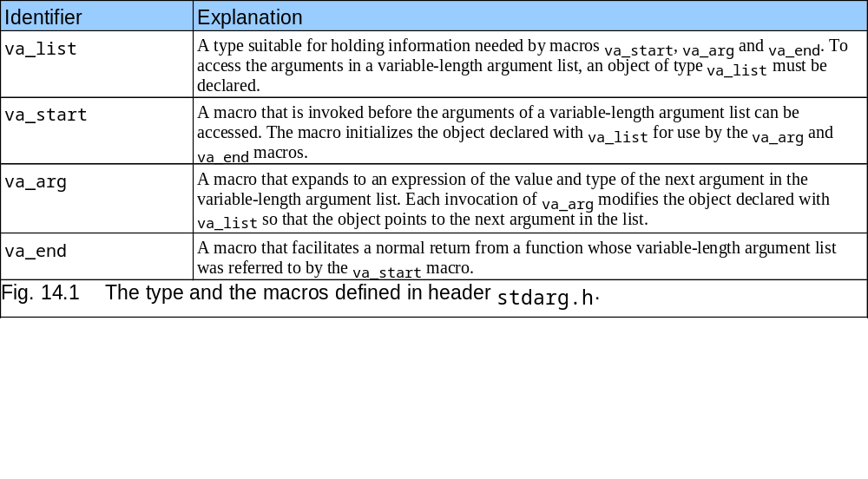
14.3 Variable-Length Argument Lists

Slide 8
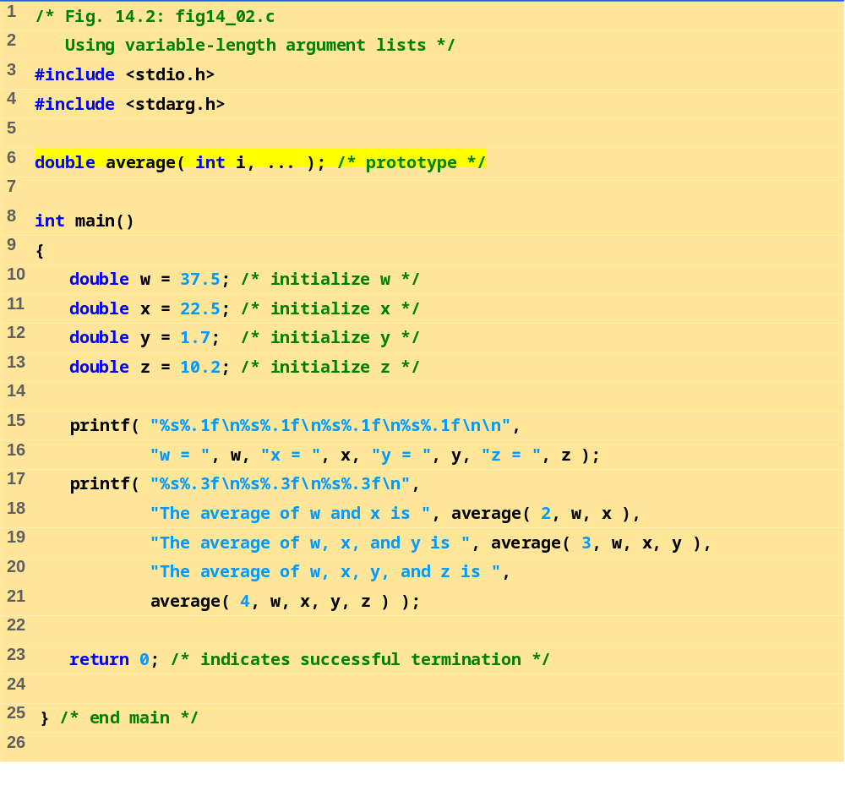
fig14_02.c (Part 1 of 2)

Slide 9
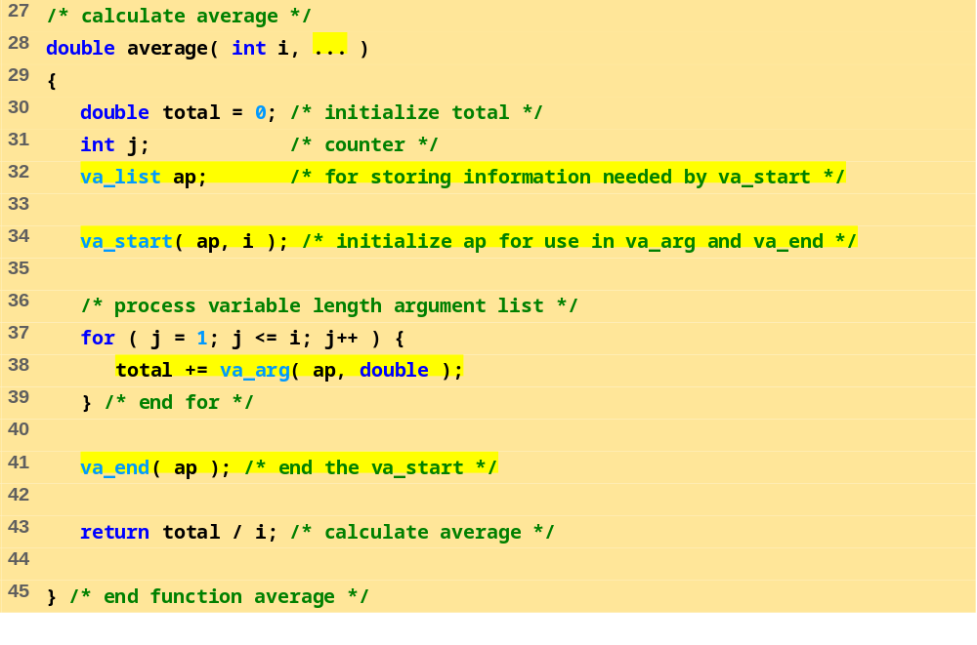
fig14_02.c (Part 2 of 2)
Program Output
w = 37.5
x = 22.5
y = 1.7
z = 10.2
The average of w and x is 30.000
The average of w, x, and y is 20.567
The average of w, x, y, and z is 17.975

Slide 10
14.4 Using Command-Line Arguments
Pass arguments to main on DOS or UNIX
  Define main as
      int main( int argc, char *argv[] )
  int argc
    Number of arguments passed
  char *argv[]
    Array of strings
    Has names of arguments in order
      argv[ 0 ] is first argument
  Example: $ mycopy input output
    argc: 3
    argv[ 0 ]: “mycopy"
    argv[ 1 ]: "input"
    argv[ 2 ]: "output"

Slide 11
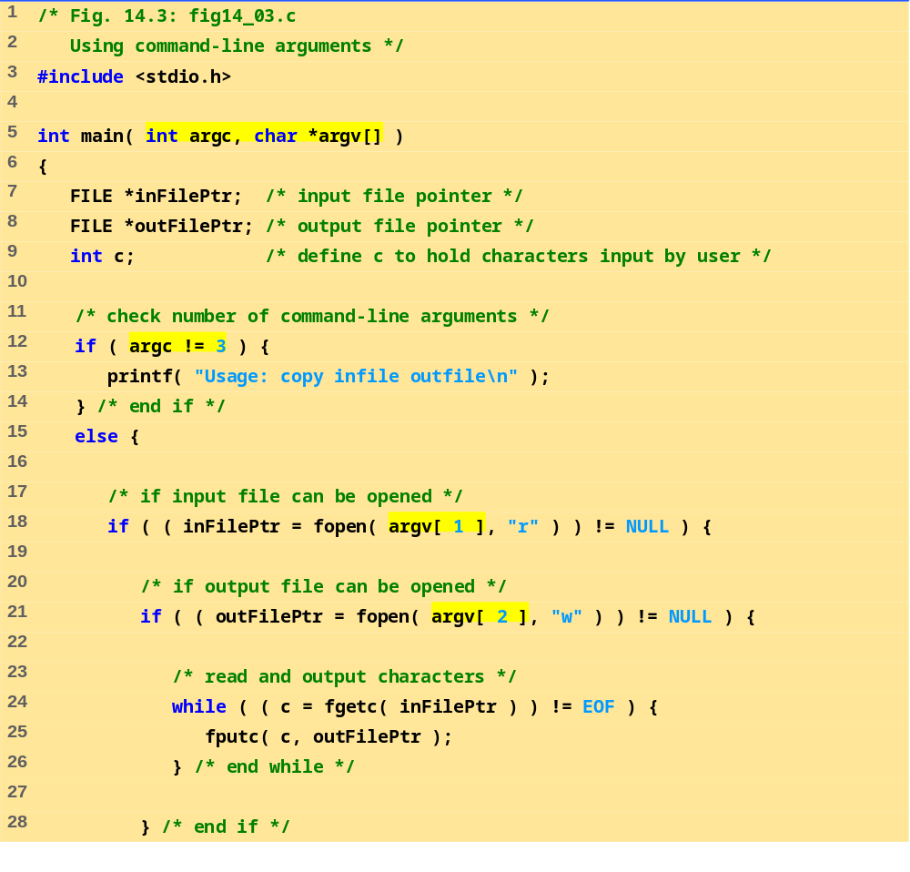
Notice argc and argv[] in main
fig14_03.c (Part 1 of 2)
argv[1] is the second argument, and is being read.
argv[2] is the third argument, and is being written to.
Loop until End Of File. fgetc a character from inFilePtr and fputc it into outFilePtr.

Slide 12
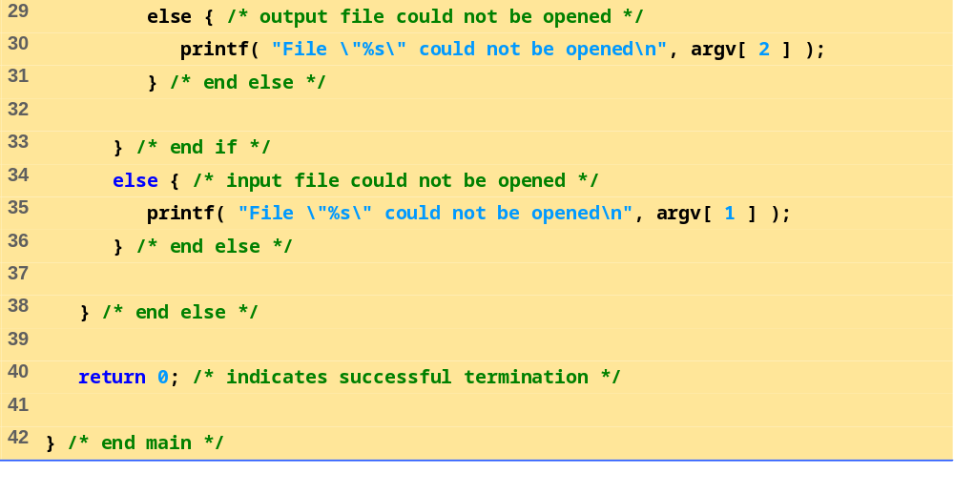
fig14_03.c (Part 2 of 2)

Slide 13
14.5 Notes on Compiling Multiple-Source-File Programs
Programs with multiple source files
  Function definition must be in one file (cannot be split up)
  Global variables accessible to functions in same file
    Global variables must be defined in every file in which they are used
  Example:
    If integer flag is defined in one file
    To use it in another file you must include the statement
      extern int flag;
  extern
    States that the variable is defined in another file
  Function prototypes can be used in other files without an extern statement
    Have a prototype in each file that uses the function

Slide 14
14.5 Notes on Compiling Multiple-Source-File Programs
Keyword static
  Specifies that variables can only be used in the file in which they are defined
Programs with multiple source files
  Tedious to compile everything if small changes have been made to only one file
  Can recompile only the changed files
  Procedure varies on system
    UNIX: make utility

Slide 15
14.6 Program Termination with exit and atexit
Function exit
  Forces a program to terminate
  Parameters – symbolic constants EXIT_SUCCESS or EXIT_FAILURE
  Returns an implementation-defined value
  Example:
      exit( EXIT_SUCCESS );
Function atexit
      atexit( functionToRun );
  Registers functionToRun to execute upon successful program termination
    atexit itself does not terminate the program
  Register up to 32 functions (multiple atexit() statements)
    Functions called in reverse register order
  Called function cannot take arguments or return values

Slide 16
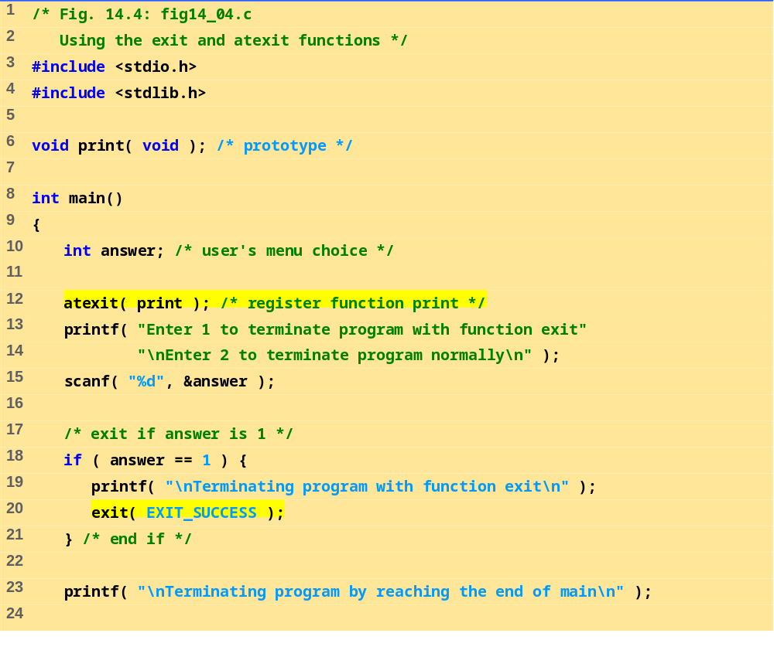
fig14_04.c (Part 1 of 2)

Slide 17
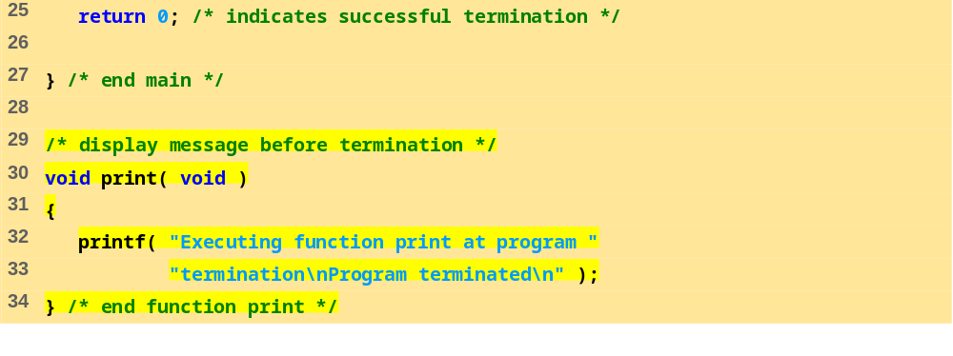
fig14_04.c (Part 2 of 2)
Program Output
Enter 1 to terminate program with function exit
Enter 2 to terminate program normally
: 1
Terminating program with function exit
Executing function print at program termination
Program terminated
Enter 1 to terminate program with function exit
Enter 2 to terminate program normally
: 2
Terminating program by reaching the end of main
Executing function print at program termination
Program terminated

Slide 18
14.7 The volatile Type Qualifier
volatile qualifier
  Variable may be altered outside program
  Variable not under control of program
  Variable cannot be optimized

Slide 19
14.8 Suffixes for Integer and Floating-Point Constants
C provides suffixes for constants
  unsigned integer – u or U
  long integer – l or L
  unsigned long integer – ul, lu, UL or LU
  float – f or F
  long double – l or L
  Examples:
        174u
        467L
        3451ul
  If integer constant is not suffixed type determined by first type capable of storing a value of that size (int, long int, unsigned long int)
  If floating point not suffixed of type double

Slide 20
14.9 More on Files
C can process binary files
  Not all systems support binary files
    Files opened as text files if binary mode not supported
  Binary files should be used when rigorous speed, storage, and compatibility conditions demand it
  Otherwise, text files are preferred
    Inherent portability, can use standard tools to examine data
Function tmpfile
  Opens a temporary file in mode "wb+"
    Some systems may process temporary files as text files
  Temporary file exists until closed with fclose or until program terminates
Function rewind
  Positions file pointers to the beginning of the file

Slide 21
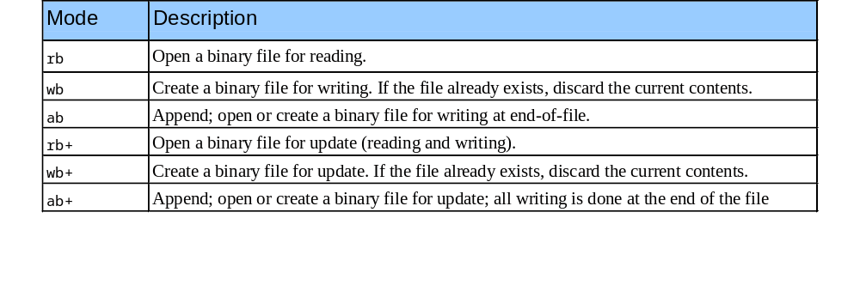
14.9 More on Files
File open modes:

Slide 22
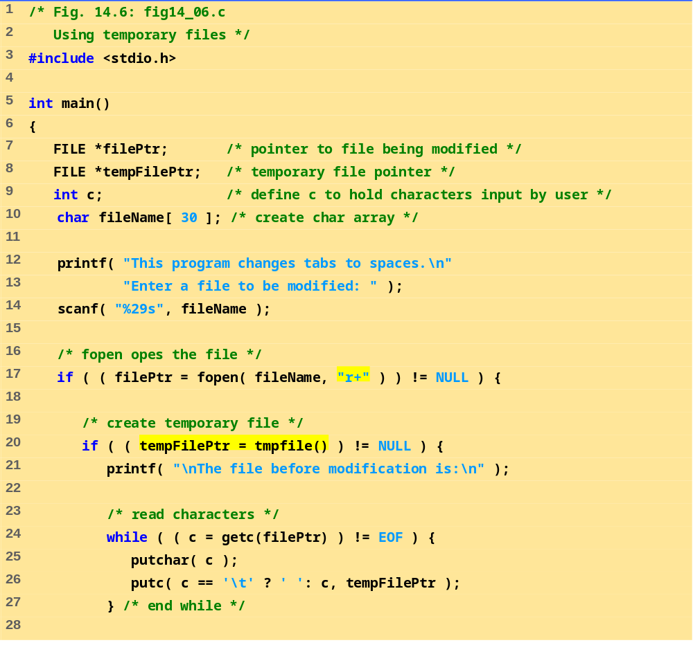
fig14_06.c (Part 1 of 2)

Slide 23
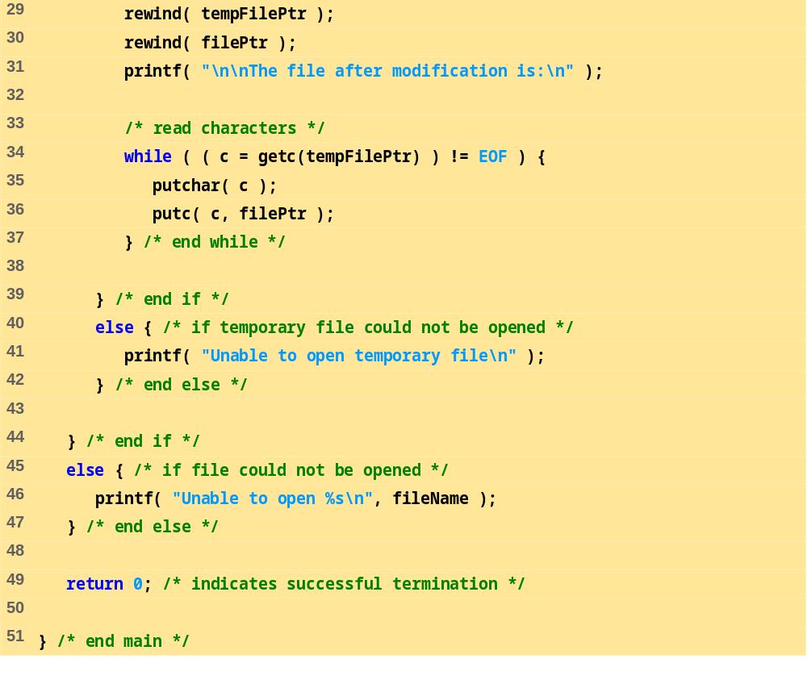
fig14_06.c (Part 2 of 2)

Slide 24
This program changes tabs to spaces.
Enter a file to be modified: data.txt
The file before modification is:
0 1 2 3 4
5 6 7 8 9
The file after modification is:
0 1 2 3 4
5 6 7 8 9
Program Output

Slide 25
14.10 Signal Handling
Signal
  Unexpected event, can terminate program
    Interrupts (<ctrl> c), illegal instructions, segmentation violations, termination orders, floating-point exceptions (division by zero, multiplying large floats)
Function signal
  Traps unexpected events
  Header <signal.h>
  Receives two arguments a signal number and a pointer to the signal handling function
Function raise
  Takes an integer signal number and creates a signal

Slide 26
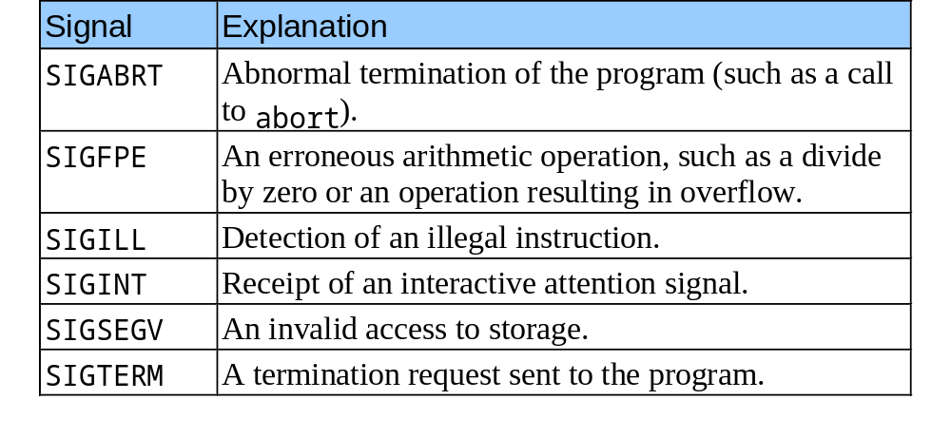
14.10 Signal Handling
Signals defined in signal.h

Slide 27
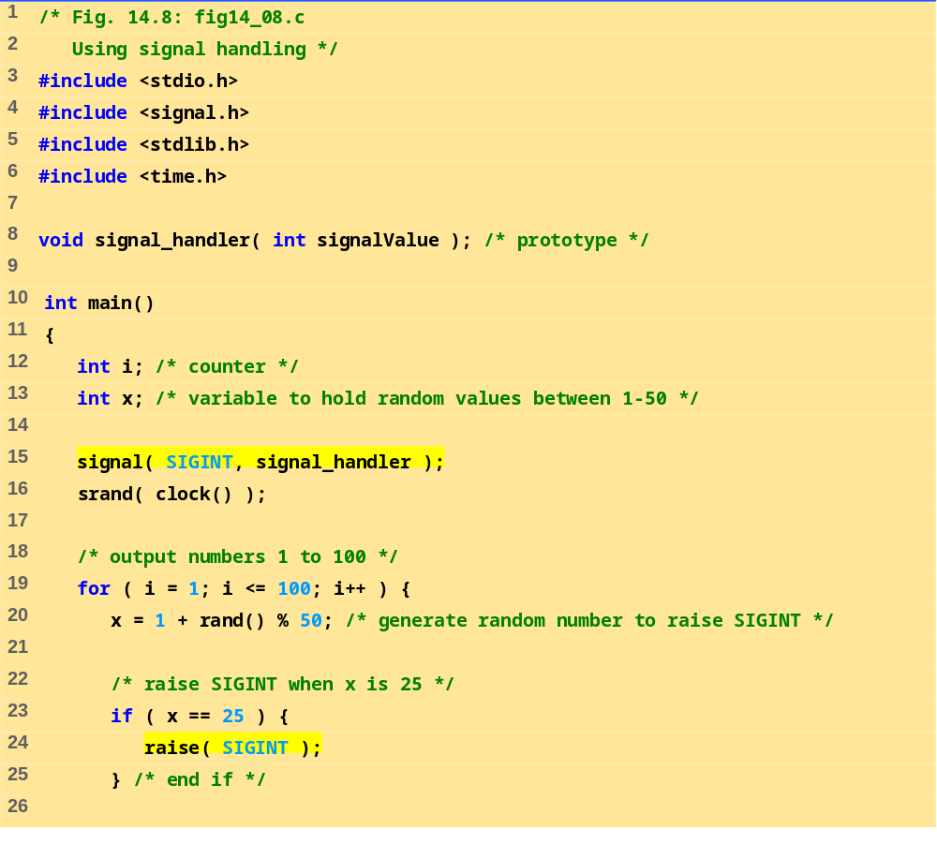
fig14_08.c (Part 1 of 3)
signal set to call function signal_handler when a signal of type SIGINT occurs.

Slide 28
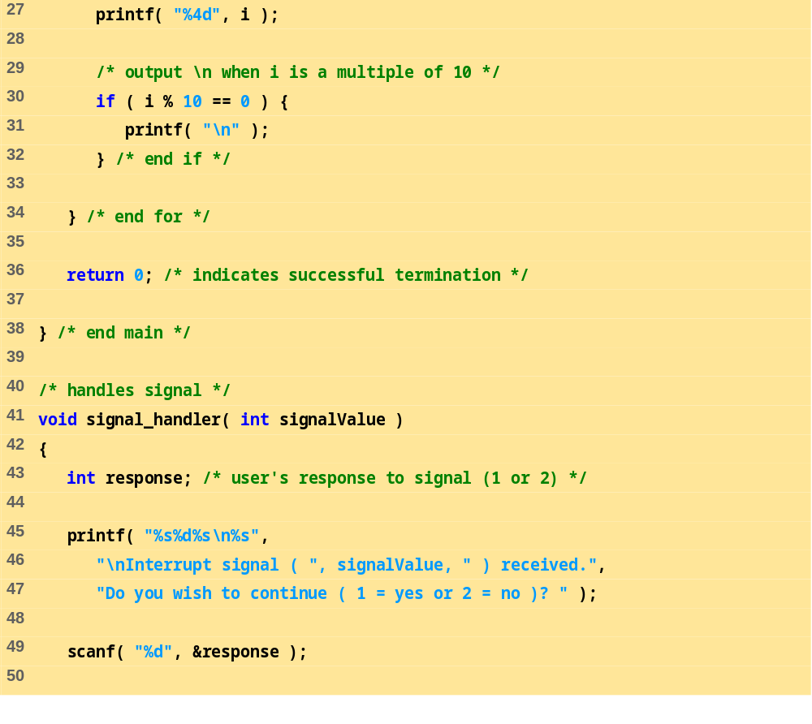
fig14_08.c (Part 2 of 3)
User given option of terminating program

Slide 29
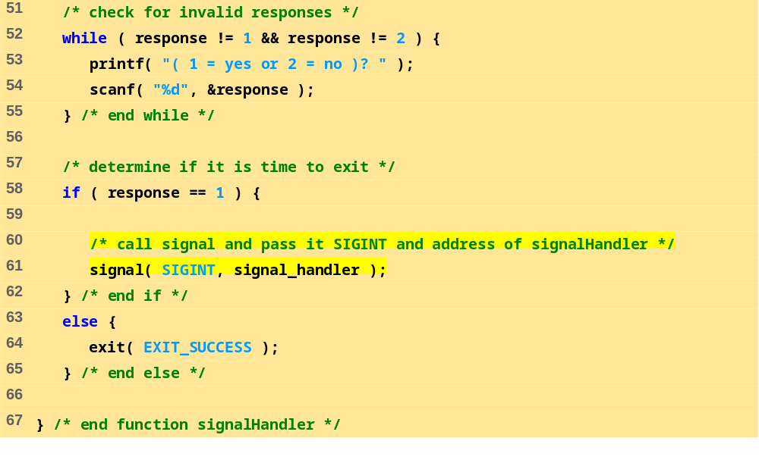
fig14_08.c (Part 3 of 3)
Signal handler reinitialized by calling signal again

Slide 30
1 2 3 4 5 6 7 8 9 10
11 12 13 14 15 16 17 18 19 20
21 22 23 24 25 26 27 28 29 30
31 32 33 34 35 36 37 38 39 40
41 42 43 44 45 46 47 48 49 50
51 52 53 54 55 56 57 58 59 60
61 62 63 64 65 66 67 68 69 70
71 72 73 74 75 76 77 78 79 80
81 82 83 84 85 86 87 88 89 90
91 92 93
Interrupt signal ( 2 ) received.
Do you wish to continue ( 1 = yes or 2 = no )? 1
94 95 96
Interrupt signal ( 2 ) received.
Do you wish to continue ( 1 = yes or 2 = no )? 2
Program Output

Slide 31
14.11 Dynamic Memory Allocation with calloc and realloc
Dynamic memory allocation
  Can create dynamic arrays
calloc( nmembers, size )
  nmembers – number of elements
  size – size of each element
  Returns a pointer to a dynamic array
realloc( pointerToObject, newSize )
  pointerToObject – pointer to the object being reallocated
  newSize – new size of the object
  Returns pointer to reallocated memory
  Returns NULL if cannot allocate space
  If newSize equals 0 then the object pointed to is freed
  If pointerToObject equals 0 then it acts like malloc

Slide 32
14.12 The Unconditional Branch: goto
Unstructured programming
  Use when performance crucial
  break to exit loop instead of waiting until condition becomes false
goto statement
  Changes flow control to first statement after specified label
  A label is an identifier followed by a colon (i.e. start:)
  Quick escape from deeply nested loop
    goto start;

Slide 33
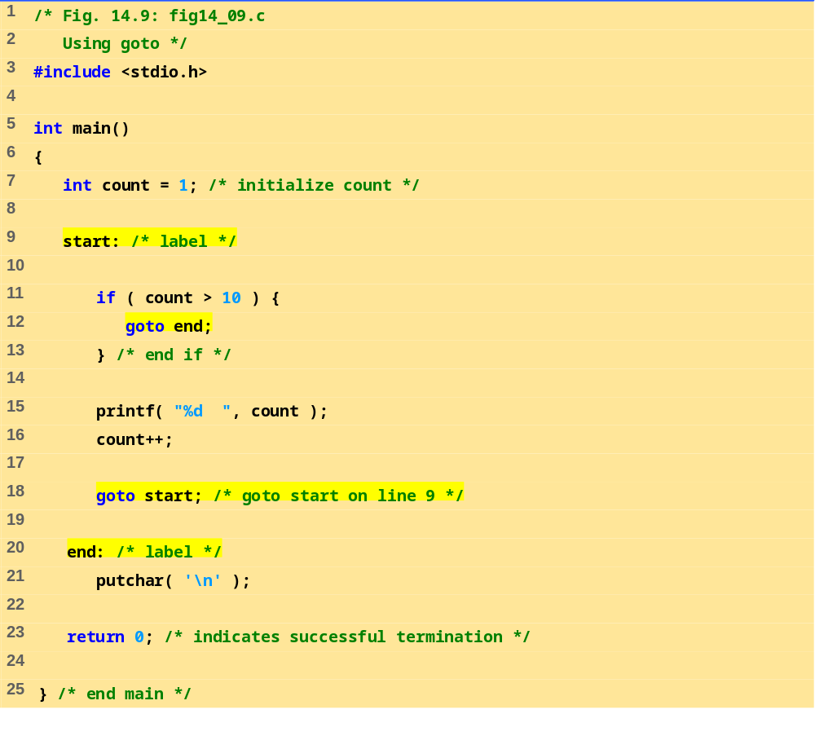
Notice how start: , end: and goto are used
fig14_09.c
Program Output
1 2 3 4 5 6 7 8 9 10

